Slide 1

healthcare cost analysis and Prediction
Vinayak Shanbhag (VXS230023)
Pranav Deshpande (pdd230000)
Sai Rajesh Jitendra (MXJ230027)

Slide 2
INTRODUCTION
Predicting healthcare costs involves data analytics and predictive modeling techniques to estimate the future healthcare expenses that an individual or a group of individuals may incur.
This process has several benefits for healthcare industries, patients, and insurance companies

Slide 3
AIM
Cost Prediction: Predictive models estimate future healthcare expenses for individuals based on historical data and patient characteristics.
Resource Allocation: Identify high-risk patients to allocate resources efficiently and provide targeted interventions to prevent costly medical events.
Risk Management: Better risk assessment and pricing of insurance policies by understanding expected healthcare utilization and expenditure patterns.
Preventive Care:
Early identification of high-risk individuals enables proactive preventive measures to avoid expensive hospitalizations or complications. We could possibly collaborate with other models which predicted high risk individuals prone to brain failure / heart related inconsistencies, etc.
Patient Empowerment: Patients gain insights into potential healthcare expenses, allowing them to make informed decisions about treatment options and insurance plans

Slide 4
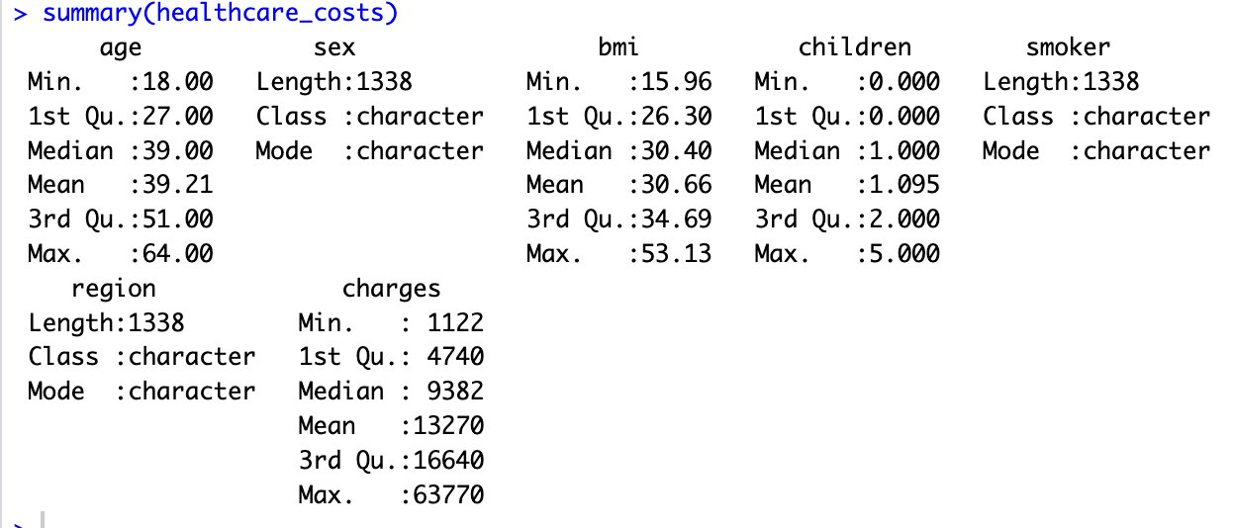
DATASET SUMMARY

Slide 5
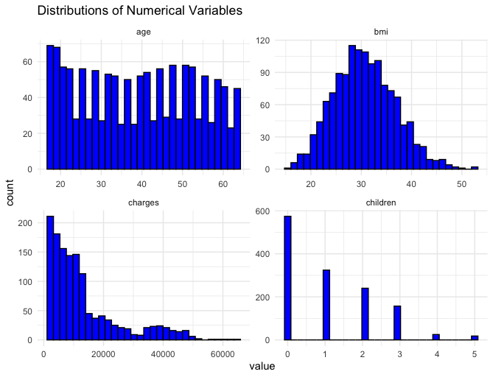
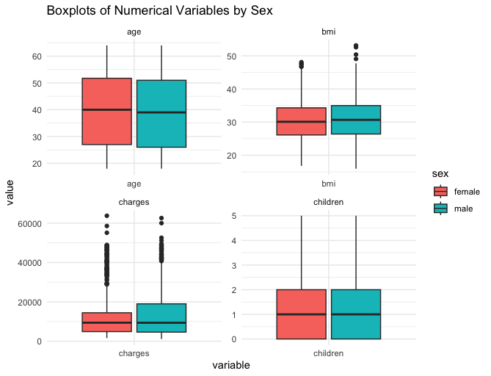
EDA

Slide 6
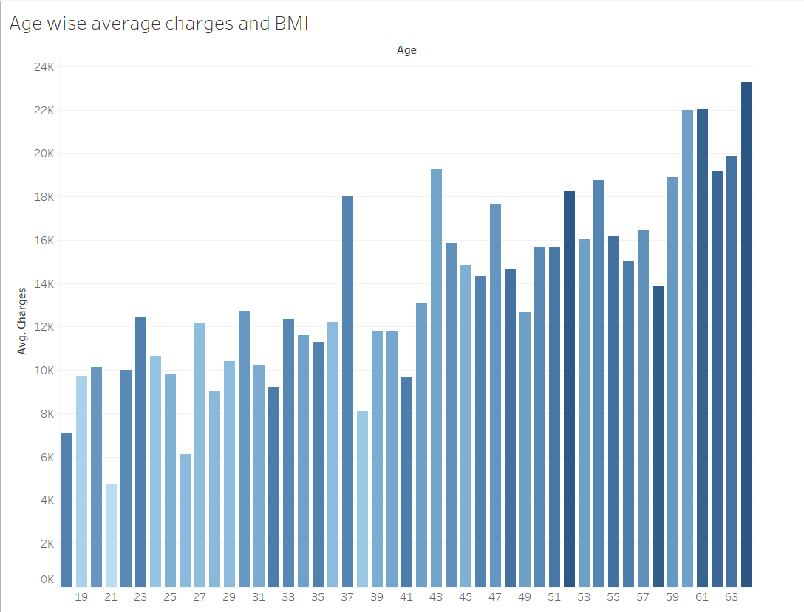

EDA
Ideal BMI is 18.5 to 24.9

Slide 7
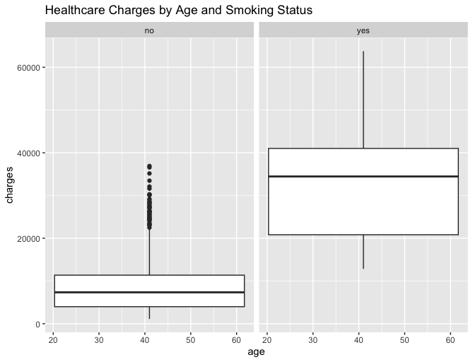
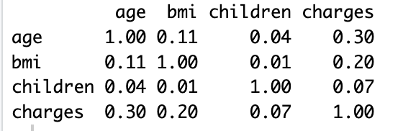
EDA
There were no missing values in the dataset.
Link: https://www.kaggle.com/code/yatindeshpande/medical-expenses-regression-models/input?select=insurance.csv
Correlation Matrix:

Slide 8
MODEL EVALUATION
Model | RMSE | MAE | R-squared
Linear Regression | 6289.89 | 4184.86 | 0.759
Random Forest | 5102.11 | 3105.99 | 0.813
XGBoost | 5477.29 | 3159.14 | 0.787
Tobit | 6244.85 | 4222.45 | NA
Support Vector Machine | 5053.46 | 2694.72 | 0.816
Gradient Boosting Machine | 4909.17 | 2935.60 | 0.826

Slide 9
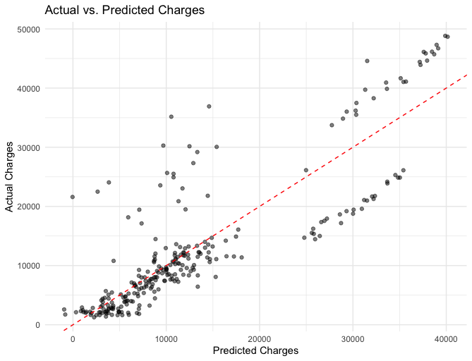

MULTI LINEAR REGRESSION
Multiple linear regression shows a decent alignment of points along the diagonal, but there's a noticeable fan-out pattern where the variance of actual charges increases with the predicted charges.
Plot shows a good alignment along the diagonal, but similarly exhibits a pattern where the predictions are more dispersed at higher charge values.

Slide 10
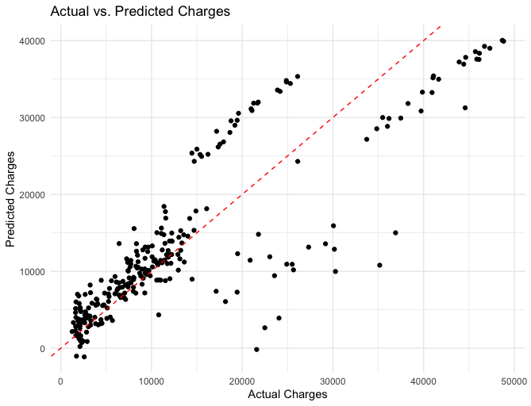

TOBIT
Actual values of the dependent variable against the predicted values to see how well the model is performing.
Plot shows a good alignment along the diagonal, but similarly exhibits a pattern where the predictions are more dispersed at higher charge values.

Slide 11
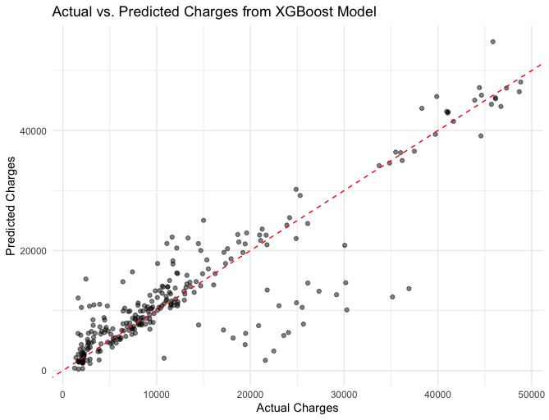

XGBOOST
Unlike previous models, predictions are not as dispersed at higher charge values.
Model predicts well for higher charges

Slide 12
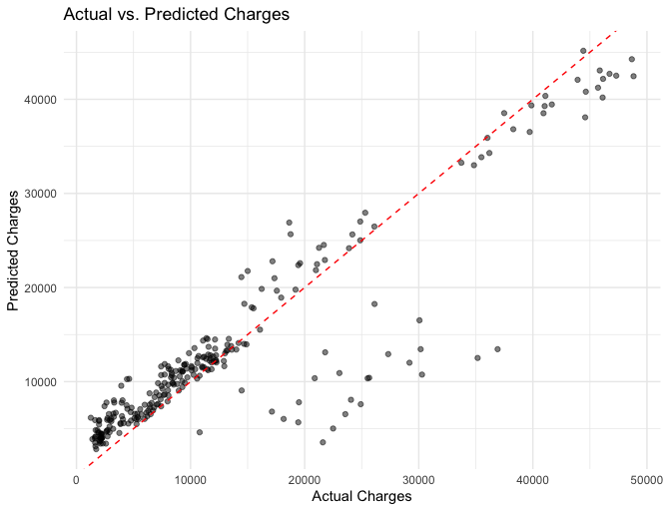

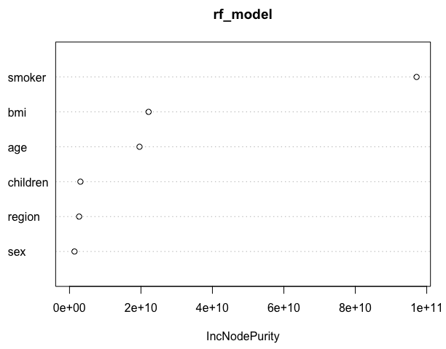
RANDOM FOREST

Slide 13
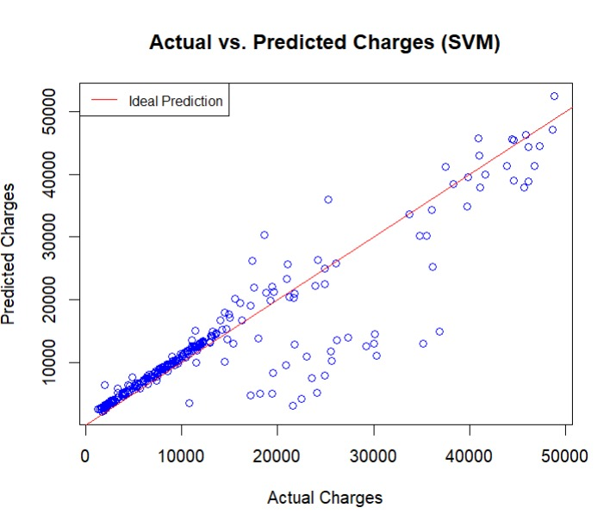
SVM
The model's predictions are visualized by the red diagonal line, serving as the benchmark for ideal forecasts.
Instances where the actual costs surpass the predicted values (below the red line) indicate suboptimal predictions, emphasizing the preference for overestimating charges to mitigate underestimation risks.

Slide 14
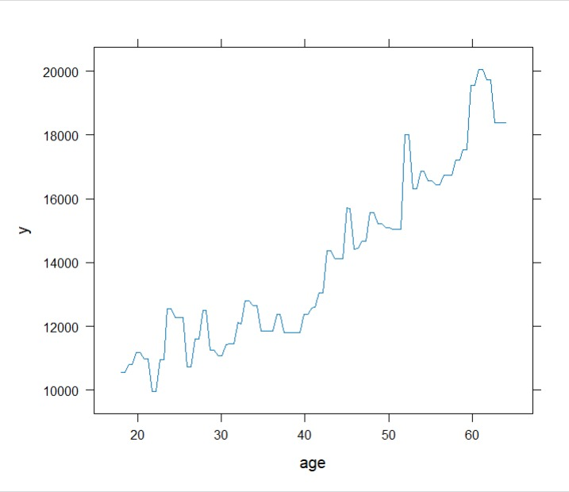
GBM
Healthcare costs exhibit a clear upward trajectory with advancing age, highlighting the evolving healthcare needs of individuals over time.
We see a spike and sudden decrease right in the beginning as when a kid is born the costs are higher than when said kid is a teenager or in their twenties.
There is a cost surge for those in twenties and thirties likely due to adventurous pursuits, sports or even tedious physical activities

Slide 15
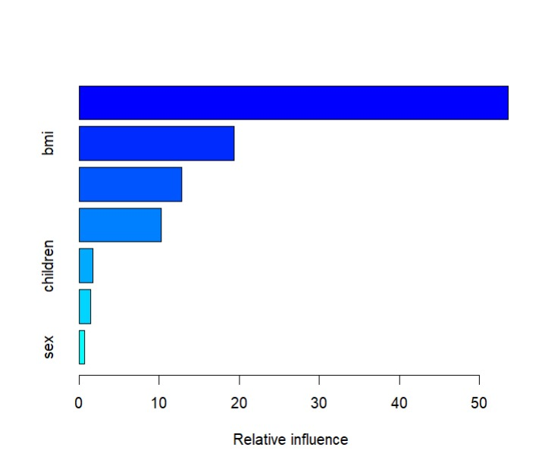
GBM
Smoker/nonsmoker emerges as the predominant factor driving healthcare costs, overshadowing the influence of BMI, Region and the number of children, emphasizing the need for tailored interventions.
While sex exerts minimal impact, the number of children and region show mild association with healthcare costs, underlining the nuanced dynamics influencing healthcare expenditures

Slide 16
RESULTS
Optimal Models : SVM and GBM demonstrated the best predictive performance with lowest RMSE and highest R-squared values.
Predictive Features : Identified key predictors of healthcare costs such as age, BMI, smoking status, and number of children.
Actionable Insights : Healthcare cost management and resource allocation.
Business Impact : Empowered healthcare industry stakeholders with valuable insights to drive decision-making and improve patient outcomes.

Slide 17
CONCLUSION
Achieved superior predictive accuracy with low RMSE and high R-squared values using SVM and GBM algorithms.
Enabled targeted interventions and proactive measures to manage costs and improve patient outcomes.
Enhanced resource allocation, financial planning for patients, and pricing strategies for insurance companies, driving innovation in healthcare delivery.

Slide 18

FUTURE SCOPE
Advanced Modeling Techniques: Explore advanced machine learning algorithms such as deep learning and ensemble methods to further improve predictive accuracy.
Real-Time Predictions: Develop real-time predictive models to enable dynamic pricing and personalized healthcare cost predictions.
Integration with Healthcare Systems: Integrate predictive models into existing healthcare systems to support decision-making by healthcare providers and insurers.
Research and Collaboration: Collaborate with researchers and healthcare professionals to continuously refine models and address emerging challenges in healthcare cost prediction.

Slide 19
FUTURE SCOPE
Incorporation of Additional Data: Incorporate additional patient data such as genetic information, lifestyle factors, and environmental data to enhance predictive capabilities.
The dataset primarily comprises patients who have had at least one hospital visit. To enhance the accuracy of healthcare expenditure predictions for the general population, it's imperative to expand the dataset to include a more diverse representation of individuals with varied healthcare utilization patterns.

Slide 20

THANK YOU

